Slide 1
Deep Neural Networks
(AIML ZG511)

Slide 2
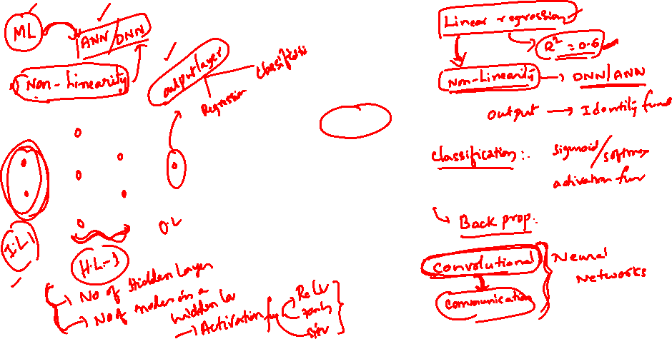
For queries related to Assignment communicate with Dr Sameera K M
km.sameera@wilp.bits-pilani.ac.in
MODULE # 6 :
CNN
Session 7
(7th June,2026)

Slide 3
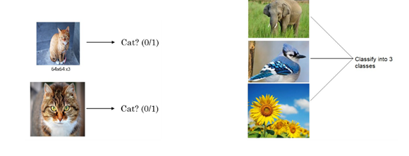
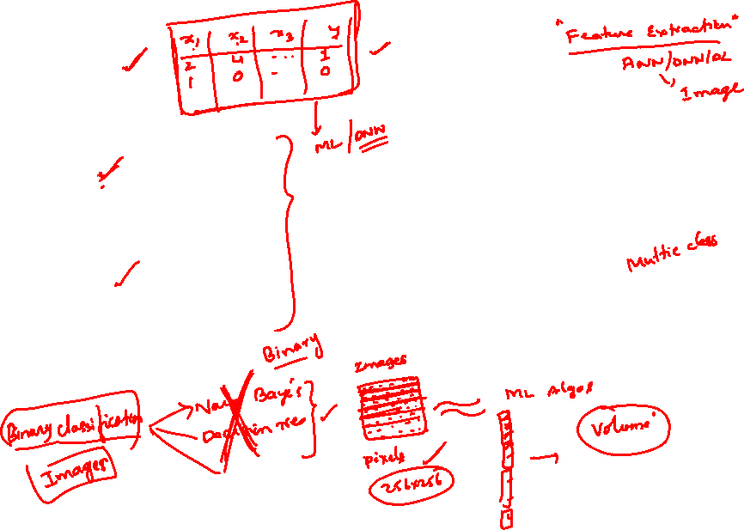
Image Classification

Slide 4
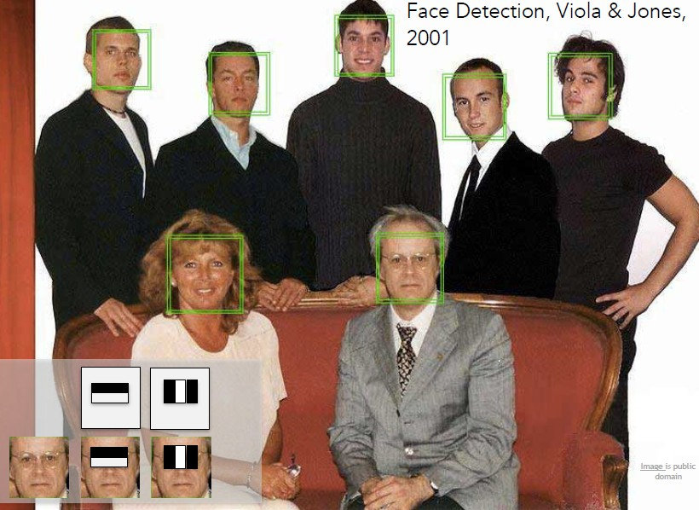
Face Detection
Fei-Fei Li & Justin Johnson & Serena Yeung

Slide 5
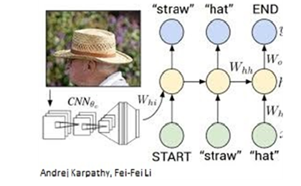
Image Captioning

Slide 6
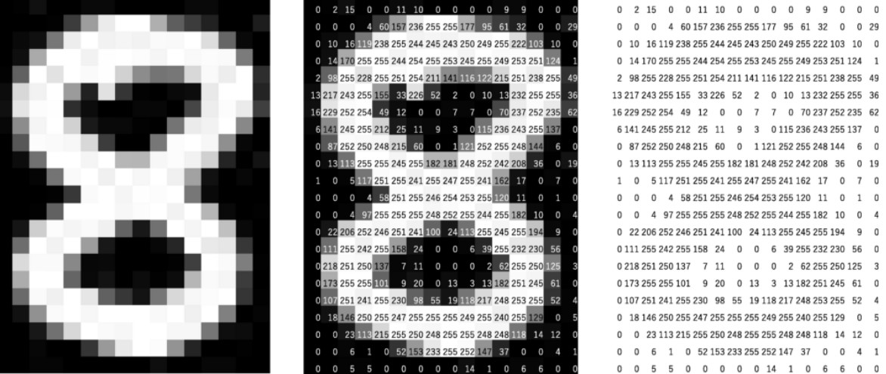
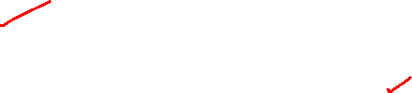
Image Basics and Image Classification Challenges
Digital Grayscale Image
Pixel intensities = I(x , y )
https://mozanunal.com/2019/11/img2sh/

Slide 7
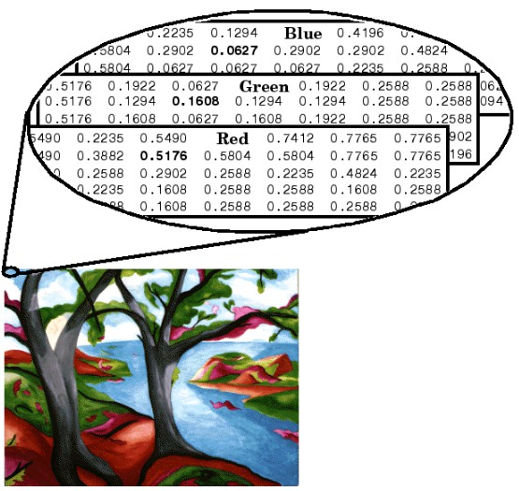
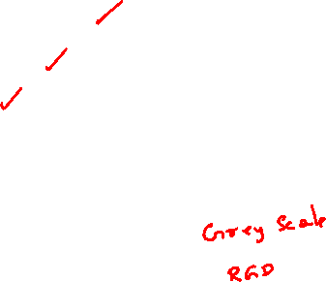
Digital Color Image
https://www.mathworks.com/help/matlab/creating_plots/image-types.html

Slide 8
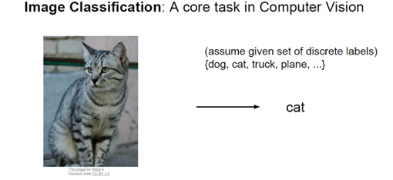
Image Classification - Challenges

Slide 9
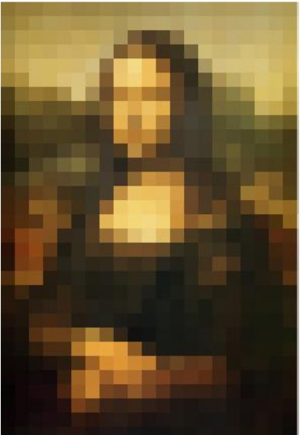
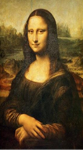
Image Classification - Challenges
Pixelated Images
textcolor Images
A 50x50 Image requires 2500 input dimensions.
A HD image 1920x1080 is about 2 million inputs. (2 Mega Pixels)

Slide 10
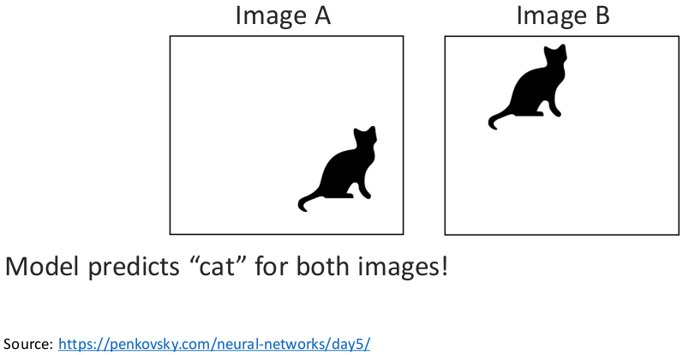
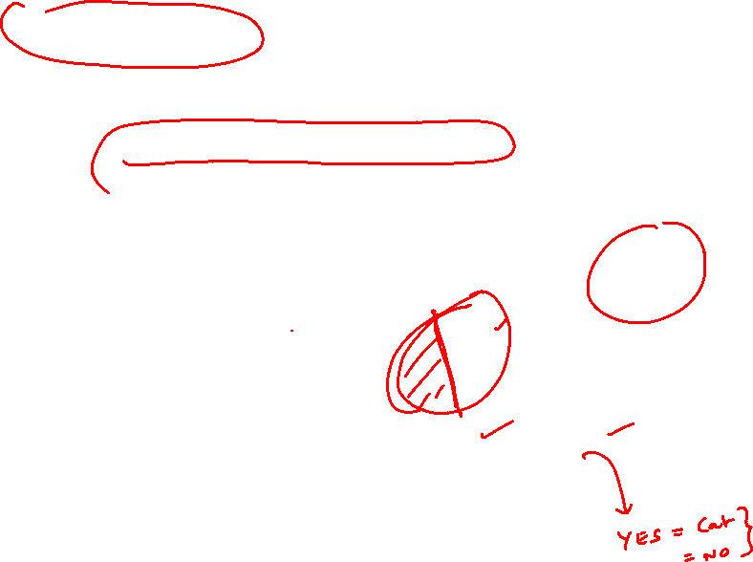
Image Invariance - Challenges
Object can appear anywhere in the image.

Slide 11
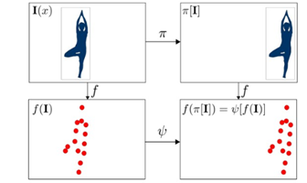
Image Equivariance - Challenges
Changes to the input predictably (equivalently) should not affect the output.

Slide 12
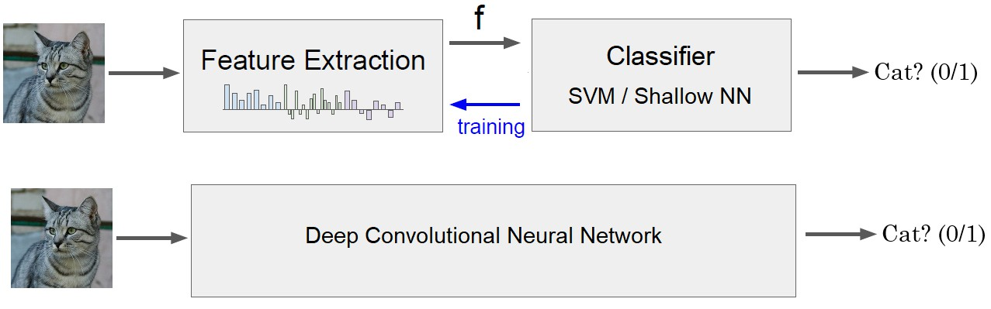
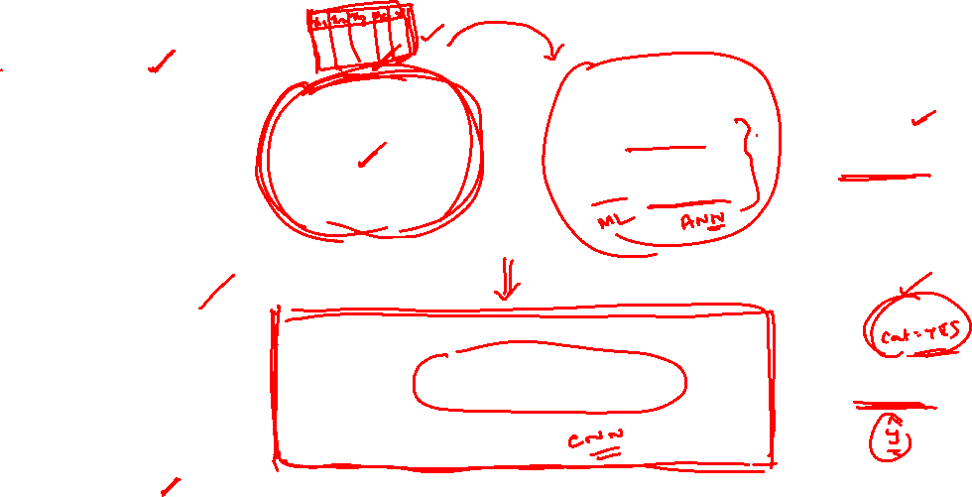
Image Classification - Solution

Slide 13
What is a Convolutional Neural Network?
Definition
A Convolutional Neural Network (CNN) is a specialized type of deep neural network designed to process data with a grid-like topology, such as images, where spatial relationships between data points are important.
Core Insight
CNNs mimic the visual cortex by detecting simple patterns (edges, corners) in early layers and combining them into complex objects (faces, cars) in deeper layers.

Slide 14
Why Convolutional Networks?
Why CNNs for Images?
Translation Invariance: Object recognition regardless of position
Local Patterns: Detect edges, textures, and shapes locally
Hierarchical Features: Low-level → Mid-level → High-level features
Parameter Efficiency: Fewer parameters than fully connected networks
Computational Efficiency: Parallel processing of convolutions

Slide 15
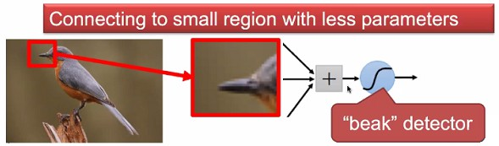
Why CNN for Images - Locality
Some patterns are much smaller than the whole image.

Slide 16
Why CNN for Images - Locality
Some patterns are much smaller than the whole image.
A neuron does not have to see the whole image to discover the pattern.

Slide 17
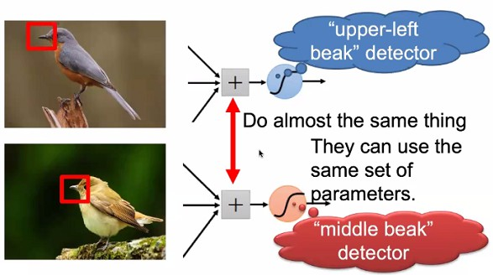
Why CNN for Images - Translation Invariance
Same pattern may appear in different regions.
Courtesy: Akka Zemmari

Slide 18
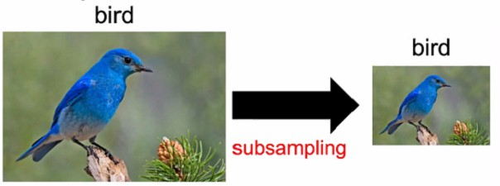
Why CNN for Images - Scale Invariance
Sub-sampling the pixels will not change the object.
We can sub-sample the image to make it smaller.
Less parameters for the network to process the image

Slide 19
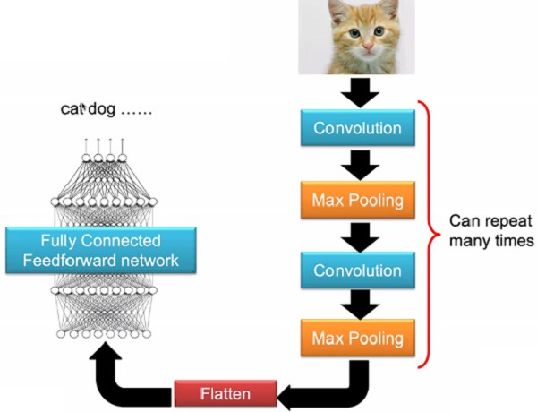
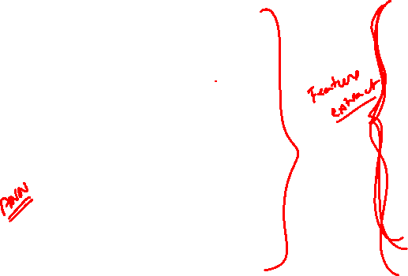
The Whole CNN

Slide 20
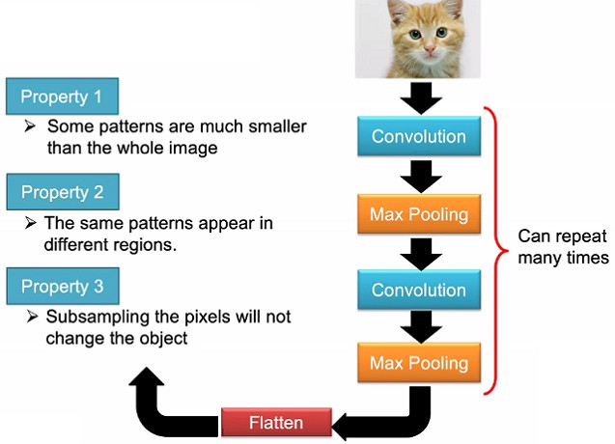
The Whole CNN

Slide 21
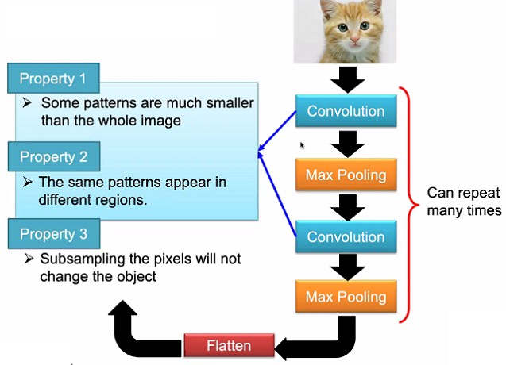
The Whole CNN

Slide 22
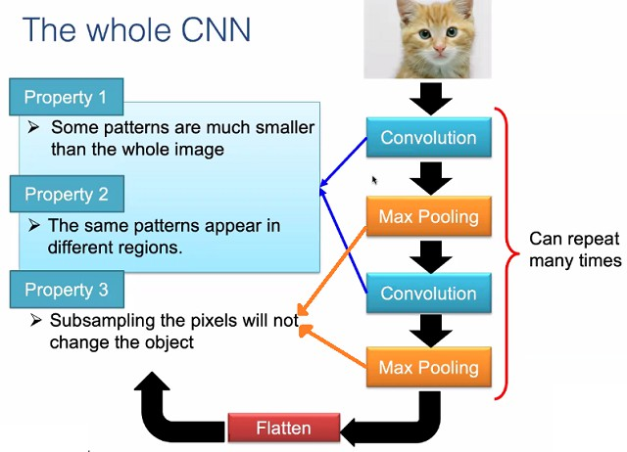
The Whole CNN

Slide 23
Key Principles of CNNs
Three Key Principles
Local Connectivity (Sparse Interactions)
Each neuron connects only to a local region of the input
Receptive field concept
Parameter Sharing
Same filter/kernel used across entire input
Dramatically reduces parameters
Equivariant Representations
If input shifts, output shifts correspondingly
Built-in translation equivariance
2
3

Slide 24
CNN Key Characteristics
Convolutional Layers: Apply learnable filters to detect local features
Pooling Layers: Reduce spatial dimensions and provide translation invariance
Hierarchical Learning: Build complex features from simple ones
Parameter Sharing: Same filter applied across entire input
Sparse Connectivity: Each neuron connects to local region only

Slide 25
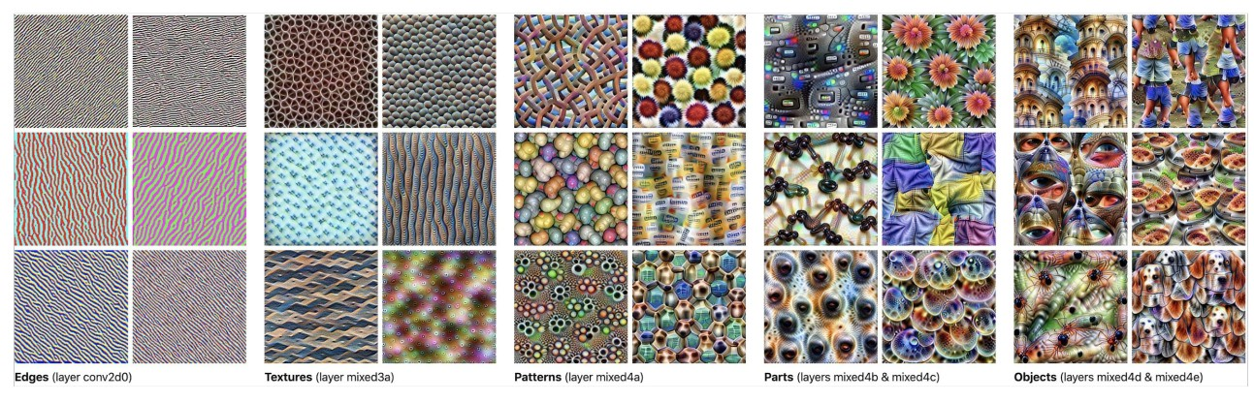
How CNN Achieves Image Classification
Hierarchical Feature Learning Process
CNNs achieve image classification through a hierarchical feature extraction process, where each layer builds increasingly complex representations from simpler ones.

Slide 26

Hierarchical Feature Learning
Deep networks learn increasingly complex features:
Edges Corners Colors
Textures
Patterns
parts
Objects
Faces
Scenes
Low-level features
Mid-level features
High-level features
Example: Face Detection
Layer 1: Detects edges at various orientations
Layer 2: Combines edges into facial features (eyes, nose, mouth)
Layer 3: Combines features into complete face

Slide 27
CNN Architecture
Architecture Pattern
INPUT → [CONV → ACTIVATION → POOL] x N → FC → OUTPUT
32×32×3
28×28×6
14×14×6
10×10×16
5×5×16
120
10
Input
Conv1
Pool1
Conv2
Pool2
FC
Output

Slide 28
CNN - Layer-by-Layer Breakdown
Early Layers (1-2)
Purpose: Detect low-level features
Features: Edges, corners, lines Filters: Small (3×3, 5×5)
Receptive Field: Local, small regions
Middle Layers (3-4)
Purpose: Combine low-level features
Features: Shapes, textures, patterns
Complexity: Medium-level abstractions
Receptive Field: textcolorBitsRedr regions

Slide 29
CNN - Layer-by-Layer Breakdown
Deep Layers (5+)
Purpose: Detect object parts
Features: Wheels, faces, eyes, ears
Complexity: High-level semantics
Receptive Field: textcolor Bits Red image regions
Fully Connected Layers
Purpose: Final classification decision
Input: Feature vector from conv layers
Output: Class probability scores
Function: Combine all learned features

Slide 30
The Classification Process
Feature Extraction: Convolutional layers progressively extract features of increasing complexity
Spatial Reduction: Pooling layers reduce spatial dimensions while preserving important information
Feature Combination: Deeper layers combine simpler features to recognize complex patterns
Decision Making: Fully connected layers use extracted features to make final classification decision
Output: Softmax layer produces probability distribution over classes
3
4
Key Insight
Each layer acts as a feature detector that becomes increasingly sophisticated. Early layers detect simple patterns, while later layers detect complex objects by combining simpler patterns.

Slide 31
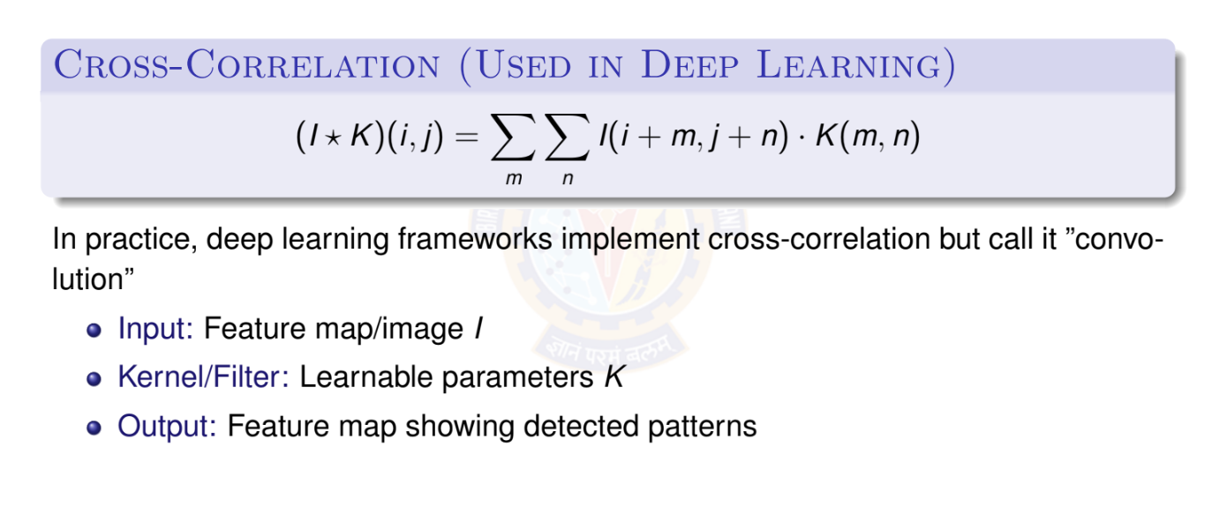
2D Convolution Operation

Slide 32
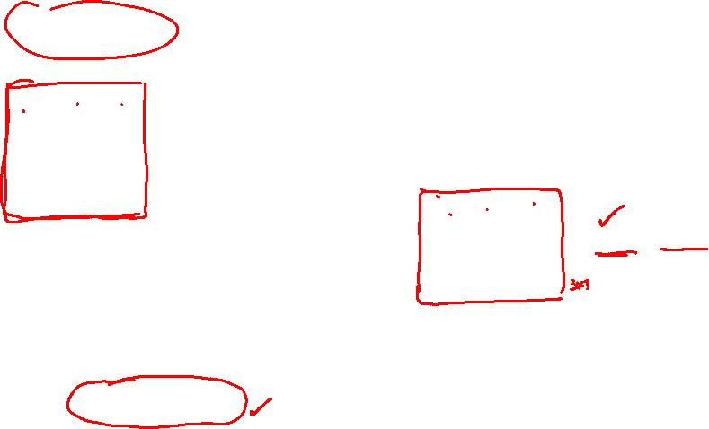
2D Convolution Operation
1 | 0 | 0 | 0 | 0 | 1
0 | 1 | 0 | 0 | 1 | 0
0 | 0 | 1 | 1 | 0 | 0
1 | 0 | 0 | 0 | 1 | 0
0 | 1 | 0 | 0 | 1 | 0
0 | 0 | 1 | 0 | 1 | 0
These values inside the matrix are to be learned by the network. We call these as parameters or weights.
Kernel / Filter 1
1 | -1 | -1
-1 | 1 | -1
-1 | -1 | 1
-1 | 1 | -1
-1 | 1 | -1
-1 | 1 | -1
Kernel / Filter 2
Input Image 6 × 6
Property 1: Each filter detects a small pattern (3 × 3)

Slide 33
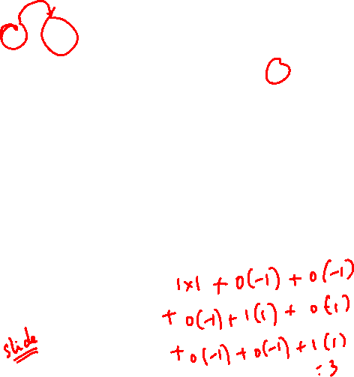
Convolution Operation
1 | 0 | 0 | 0 | 0 | 1
0 | 1 | 0 | 0 | 1 | 0
0 | 0 | 1 | 1 | 0 | 0
1 | 0 | 0 | 0 | 1 | 0
0 | 1 | 0 | 0 | 1 | 0
0 | 0 | 1 | 0 | 1 | 0
Start at top left corner. Perform element wise product and add all the values.
1 | -1 | -1
-1 | 1 | -1
-1 | -1 | 1
Filter 1
Output
3
Input Image 6 × 6

Slide 34
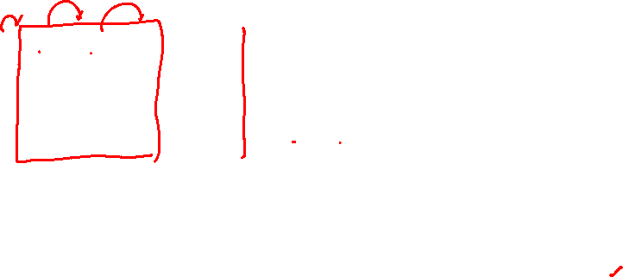
Convolution Operation
1 | 0 | 0 | 0 | 0 | 1
0 | 1 | 0 | 0 | 1 | 0
0 | 0 | 1 | 1 | 0 | 0
1 | 0 | 0 | 0 | 1 | 0
0 | 1 | 0 | 0 | 1 | 0
0 | 0 | 1 | 0 | 1 | 0
Slide by one pixel towards right.
Perform element wise product and add all the values.
Filter 1
1 | -1 | -1
-1 | 1 | -1
-1 | -1 | 1
Output
3 -1
Input Image 6 × 6

Slide 35
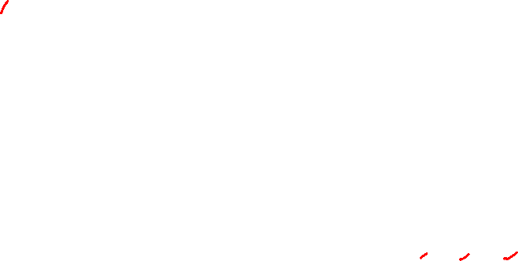
Convolution Operation
stride s = 1
1 | 0 | 0 | 0 | 0 | 1
0 | 1 | 0 | 0 | 1 | 0
0 | 0 | 1 | 1 | 0 | 0
1 | 0 | 0 | 0 | 1 | 0
0 | 1 | 0 | 0 | 1 | 0
0 | 0 | 1 | 0 | 1 | 0
Slide by one pixel towards right.
Perform element wise product and add all the values.
Filter 1
Output
3 -1
1 | -1 | -1
-1 | 1 | -1
-1 | -1 | 1
Input Image 6 × 6

Slide 36
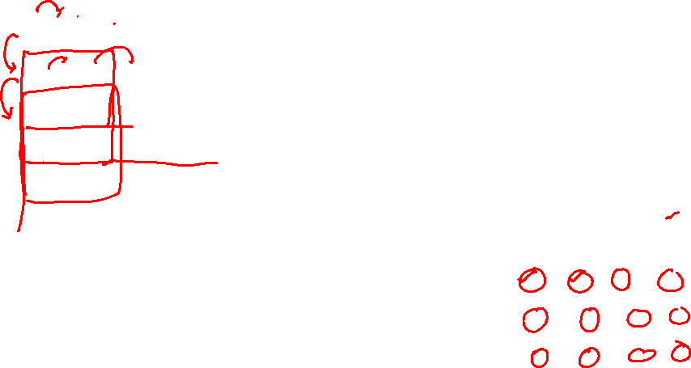
Convolution Operation
stride s = 1
1 | 0 | 0 | 0 | 0 | 1
0 | 1 | 0 | 0 | 1 | 0
0 | 0 | 1 | 1 | 0 | 0
1 | 0 | 0 | 0 | 1 | 0
0 | 1 | 0 | 0 | 1 | 0
0 | 0 | 1 | 0 | 1 | 0
Slide by one pixel towards right.
Perform element wise product and add all the values.
Filter 1
Output
3 -1 -3 -1
1 | -1 | -1
-1 | 1 | -1
-1 | -1 | 1
Input Image 6 × 6

Slide 37
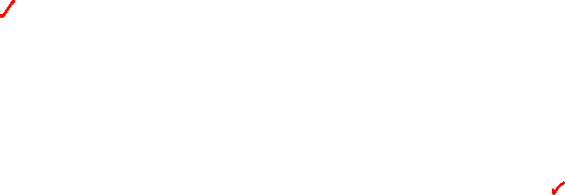
Convolution Operation
stride s = 1
Jump to next row, left most pixel.
The filter has to completely superimpose the pixels of input.
NOT PARTIALLY.
1 | 0 | 0 | 0 | 0 | 1
0 | 1 | 0 | 0 | 1 | 0
0 | 0 | 1 | 1 | 0 | 0
1 | 0 | 0 | 0 | 1 | 0
0 | 1 | 0 | 0 | 1 | 0
0 | 0 | 1 | 0 | 1 | 0
1 | -1 | -1
-1 | 1 | -1
-1 | -1 | 1
Filter 1
Output
3 -1 -3 -1
Input Image 6 × 6
-3

Slide 38
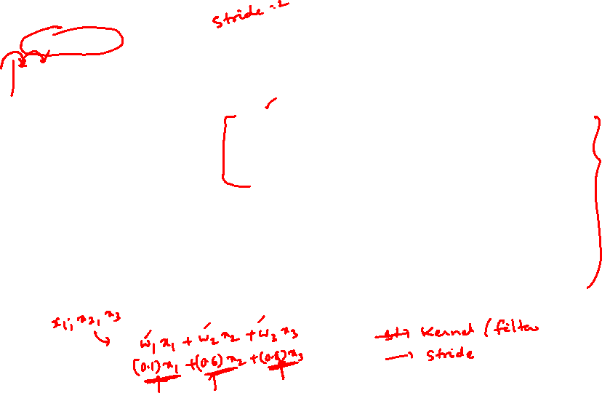
Convolution Operation
stride s = 1
After sliding through the entire image.
3 -1 -3 -1
-3 -1 0 -3
-3 -2 0 1
3 -2 -2 -1
Output Feature Map
1 | 0 | 0 | 0 | 0 | 1
0 | 1 | 0 | 0 | 1 | 0
0 | 0 | 1 | 1 | 0 | 0
1 | 0 | 0 | 0 | 1 | 0
0 | 1 | 0 | 0 | 1 | 0
0 | 0 | 1 | 0 | 1 | 0
1 | -1 | -1
-1 | 1 | -1
-1 | -1 | 1
Filter 1
Input Image 6 × 6

Slide 39
Convolution Operation
stride s = 1
3 -1 -3 -1
1 | 0 | 0 | 0 | 0 | 1
0 | 1 | 0 | 0 | 1 | 0
0 | 0 | 1 | 1 | 0 | 0
1 | 0 | 0 | 0 | 1 | 0
0 | 1 | 0 | 0 | 1 | 0
0 | 0 | 1 | 0 | 1 | 0
-3 -1 0 -3
-3 -2 0 1
1 | -1 | -1
-1 | 1 | -1
-1 | -1 | 1
3 -2 -2 - 1
Output Feature Map
Filter 1
Input Image 6 × 6
Property 2 is satisfied.

Slide 40
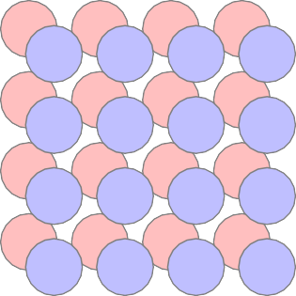
Convolution Operation
Filter 1
Filter 2
stride s = 1
1 | -1 | -1 | -1 | 1 | -1
-1 | 1 | -1 | -1 | 1 | -1
-1 | -1 | 1 | -1 | 1 | -1
1 | 0 | 0 | 0 | 0 | 1
0 | 1 | 0 | 0 | 1 | 0
0 | 0 | 1 | 1 | 0 | 0
1 | 0 | 0 | 0 | 1 | 0
0 | 1 | 0 | 0 | 1 | 0
0 | 0 | 1 | 0 | 1 | 0
3 -1 | -1 -1 | -3 -1 | -1 -1
-3 -1 | -1 -1 | 0 -2 | -3 -1 | Feature
-3 -1 | -2 -1 | 0 -2 | 1 1 | Maps
3 -1 | -2 0 | -2 -4 | -1 3
Input Image 6 × 6

Slide 41
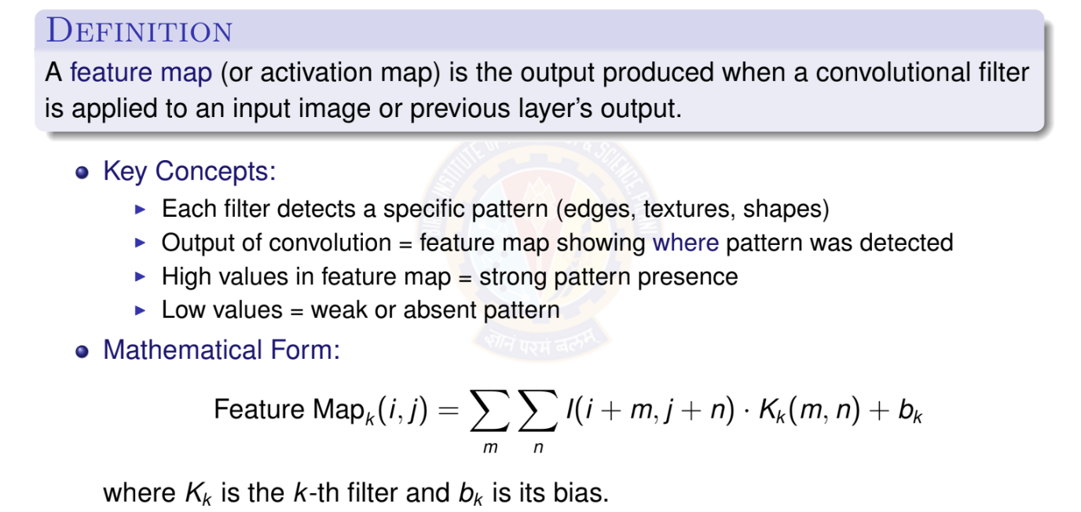
What is a Feature Map?

Slide 42
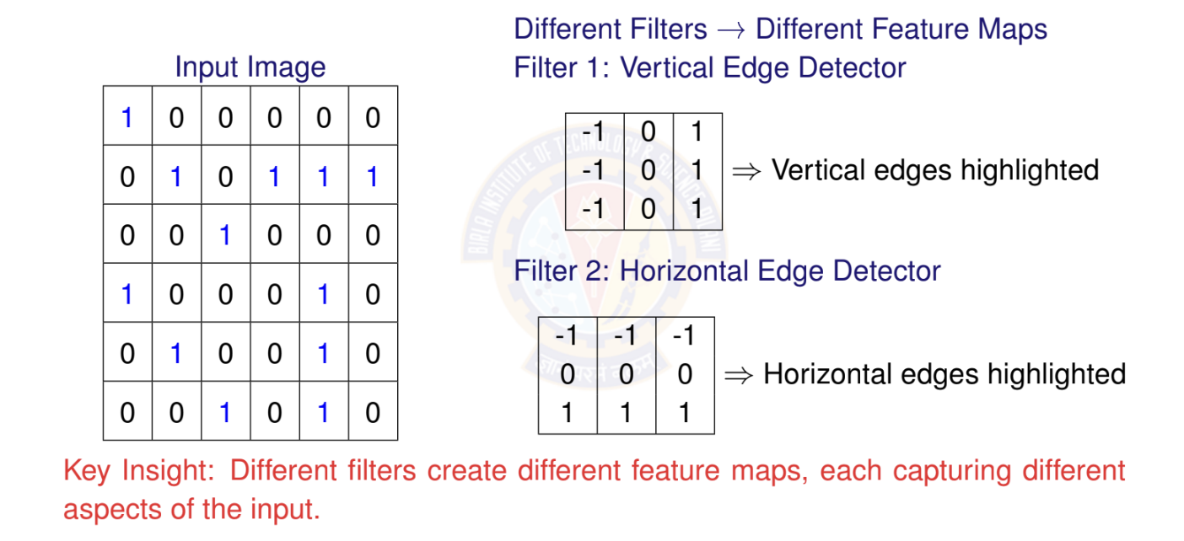
Feature Maps: Visual Example

Slide 43
Multiple Feature Maps in CNNs
Single Convolutional Layer with Multiple Filters:
64 Filters
3 × 3
Input
32 × 32 × 3
64 Feature Maps
30 × 30 × 64
Important:
Number of filters = Number of output feature maps
Each feature map = One filter’s response across entire input
Stack of feature maps = 3D volume (height × width × channels)

Slide 44
Receptive Field: Definition
Definition
The receptive field of a neuron is the region in the input image that affects that neuron’s activation value.
Key Concepts:
Receptive field grows with network depth
Early layers: small receptive fields (local patterns)
Deep layers: large receptive fields (global context)
Determined by kernel size, stride, and pooling
Importance:
Small receptive field: Cannot capture large objects
Large receptive field: Better context understanding
Trade-off: Computational cost vs. context

Slide 45
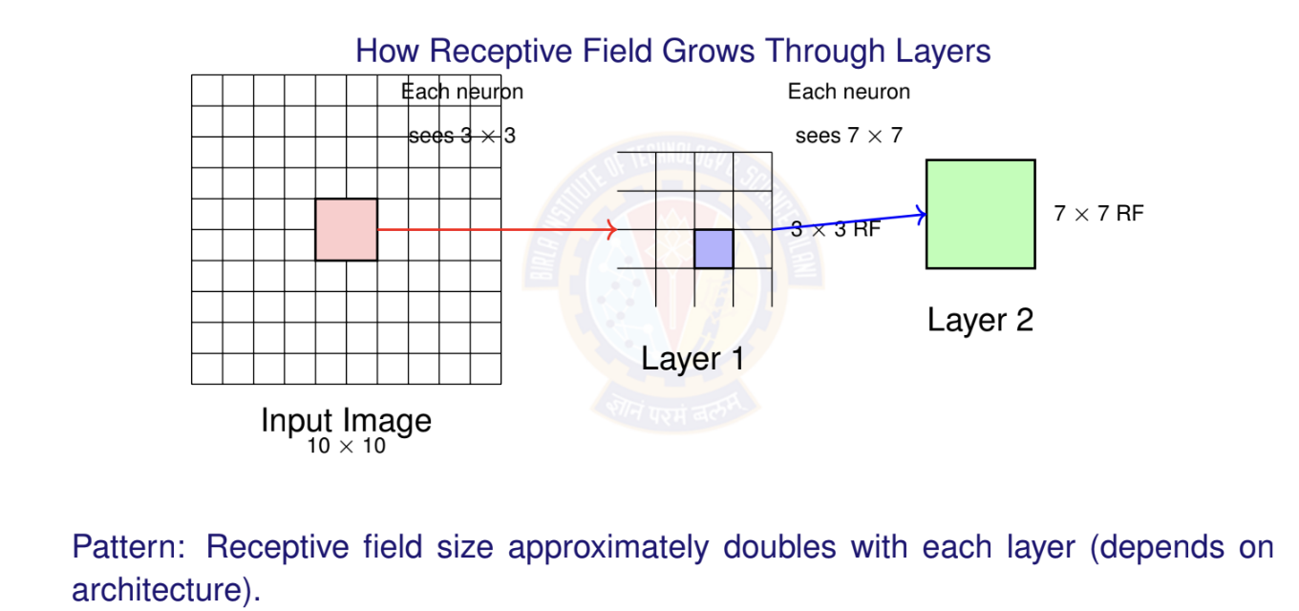
Receptive Field: Visual Example

Slide 46
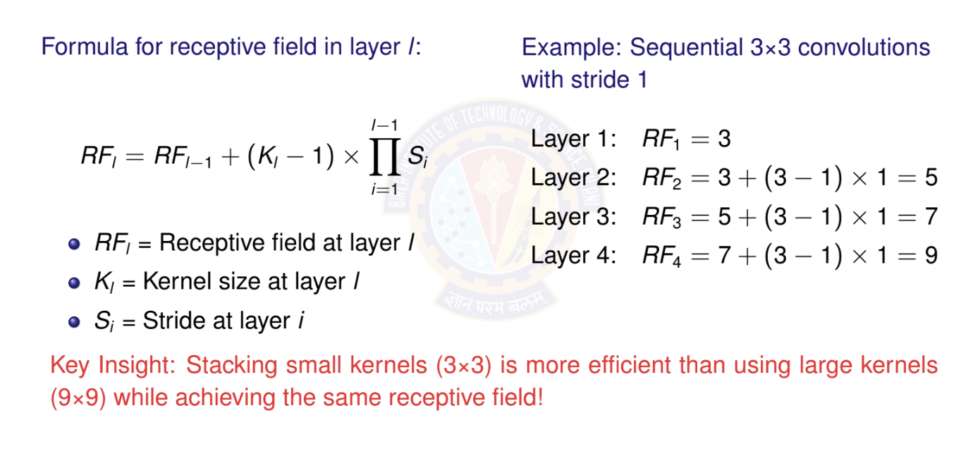
Receptive Field: Calculation

Slide 47
Learning a Kernel: Overview
Key Question
How does the network learn what values to put in the convolutional kernels/filters?
Answer: Through Gradient Descent!
Kernel weights are learnable parameters (like weights in fully connected layers)
Initialized randomly (or with specific strategies)
Updated via backpropagation and gradient descent
Network learns kernels that minimize the loss function
Process:
Random kernels ^{Training}
——→ Meaningful edge/texture/pattern detectors

Slide 48
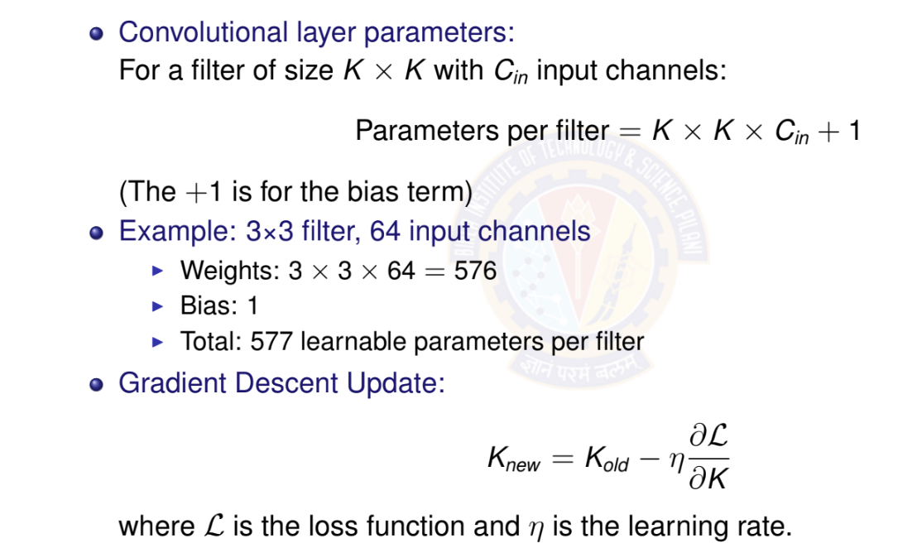
Kernels as Parameters

Slide 49
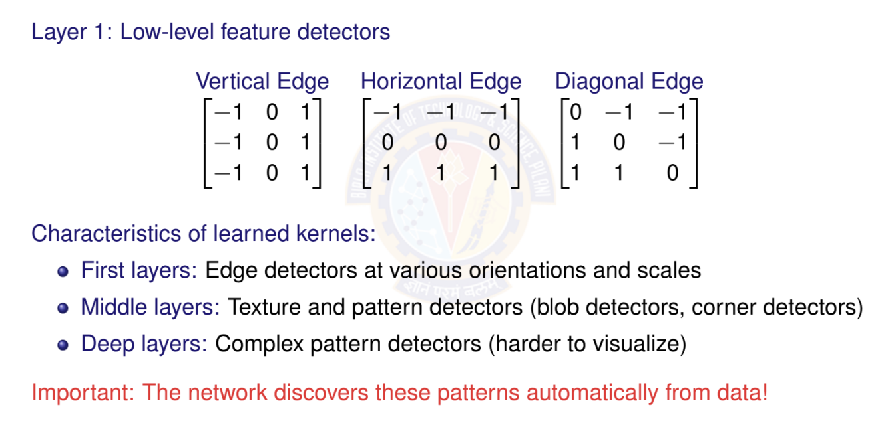
What Do Learned Kernels Look Like?

Slide 50
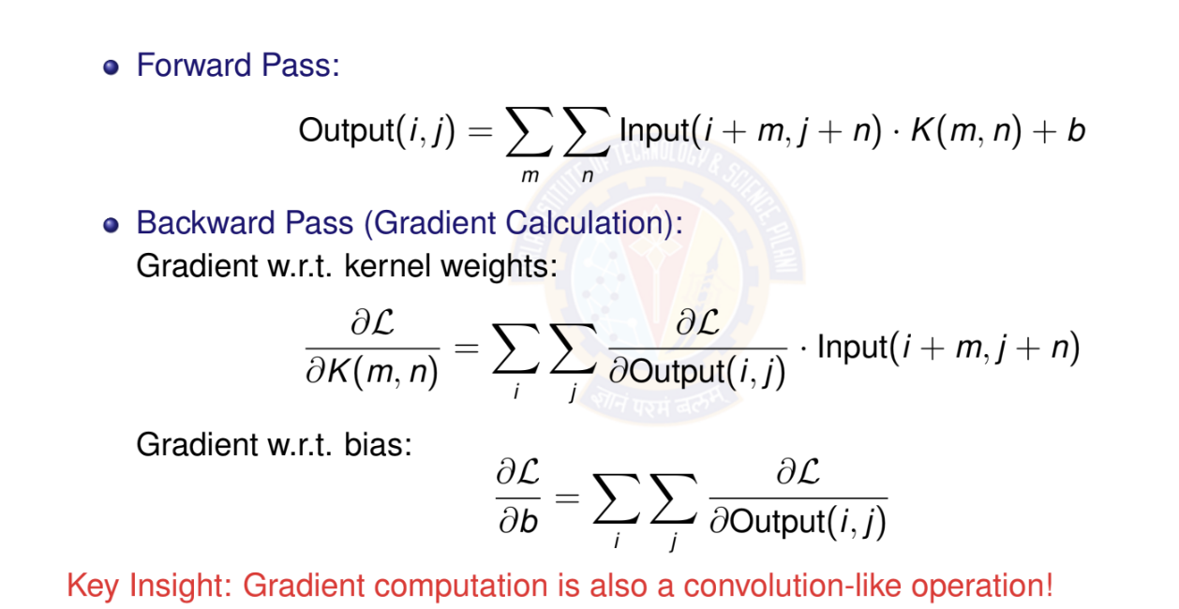
Learning Kernels: Backpropagation Through

Slide 51
Padding
Why Padding?
Without padding: Output size = Input size - Kernel size + 1
Information at borders gets less attention
Deep networks would shrink feature maps rapidly
Types of Padding
Valid Padding: No padding (output smaller than input)
Same Padding: Pad to keep output size = input size
Full Padding: Maximum padding
Same Padding Calculation
For kernel size k and stride s = 1: Padding = (k — 1)/2

Slide 52
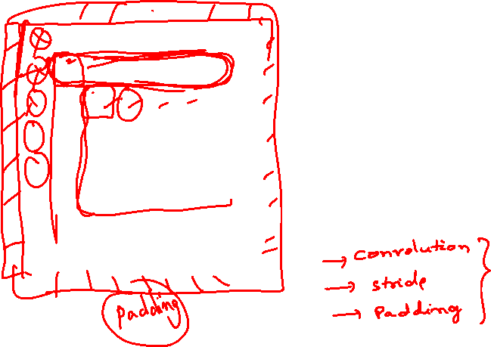
Convolution with Padding
Input Image with padding 8 × 8
0 | 0 | 0 | 0 | 0 | 0 | 0 | 0
0 | 1 | 0 | 0 | 0 | 0 | 1 | 0
0 | 0 | 1 | 0 | 0 | 1 | 0 | 0
0 | 0 | 0 | 1 | 1 | 0 | 0 | 0
0 | 1 | 0 | 0 | 0 | 1 | 0 | 0
0 | 0 | 1 | 0 | 0 | 1 | 0 | 0
0 | 0 | 0 | 1 | 0 | 1 | 0 | 0
0 | 0 | 0 | 0 | 0 | 0 | 0 | 0
Filter1
*
1 | -1 | -1
-1 | 1 | -1
-1 | -1 | 1

Slide 53
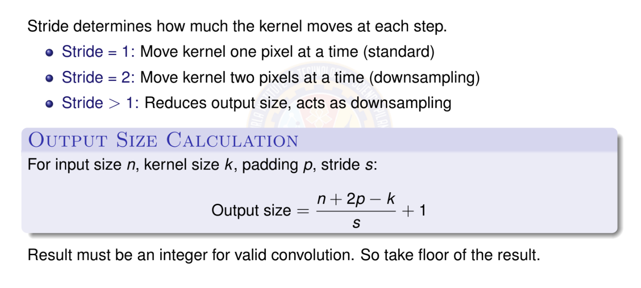
Stride

Slide 54
Convolution Operation with Stride
stride s = 3
1 | 0 | 0 | 0 | 0 | 1
0 | 1 | 0 | 0 | 1 | 0
0 | 0 | 1 | 1 | 0 | 0
1 | 0 | 0 | 0 | 1 | 0
0 | 1 | 0 | 0 | 1 | 0
0 | 0 | 1 | 0 | 1 | 0
1 | -1 | -1
-1 | 1 | -1
-1 | -1 | 1
3 -1
3 -1
Feature Map 2x2
Filter1
Input Image 6 × 6

Slide 55
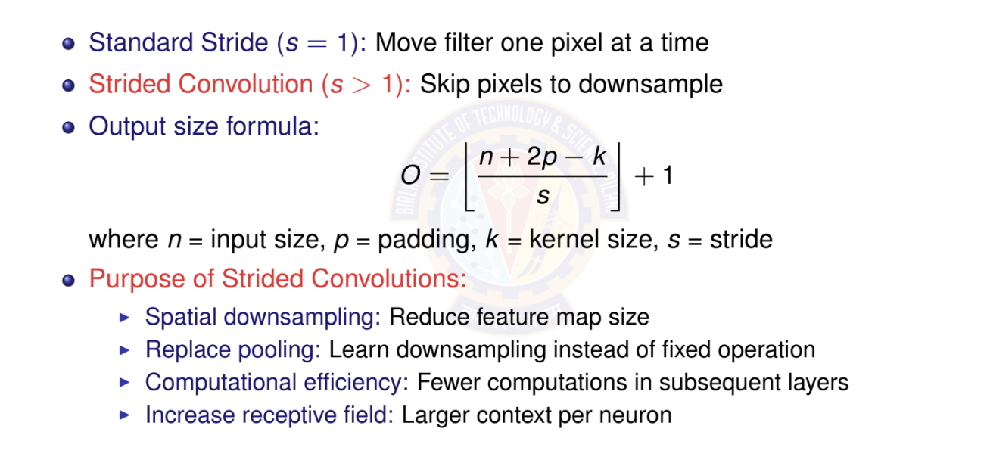
Strided Convolution

Slide 56
Strided Convolution: Example
Stride = 2 Example:
31 | 32 | 33 | 34 | 35 | 36
25 | 26 | 27 | 28 | 29 | 30
19 | 20 | 21 | 22 | 23 | 24
13 | 14 | 15 | 16 | 17 | 18
7 | 8 | 9 | 10 | 11 | 12
1 | 2 | 3 | 4 | 5 | 6
1 | 2
3 | 4
Input: 6 × 6
3 × 3 kernel
Output: 2 × 2 (stride=2)
With stride = 2: Output size = ⁶⁻³ + 1 = 2
2
Trade-off: Lose spatial resolution but gain computational efficiency

Slide 57
Dilated (Atrous) Convolution
Definition
Dilated convolution (also called atrous convolution) inserts spaces (holes) between kernel elements to increase receptive field without increasing parameters.
Dilation rate r : Number of pixels between kernel elements
r = 1: Standard convolution (no dilation)
r = 2: One pixel gap between kernel elements
r = 3: Two pixel gaps between elements
Effective receptive field:
k_{eff} = k + (k — 1)(r — 1)
where k = kernel size, r = dilation rate
Example: 3 × 3 kernel with r = 2 effective 5 × 5 receptive field

Slide 58
Dilated Convolution: Visual Example
Standard vs. Dilated Convolution
Standard (r = 1)
Dilated (r = 2)
Receptive field: 3 × 3
Receptive field: 5 × 5
Key Advantage: Same number of parameters (9), but larger receptive field!

Slide 59
Dilated Convolution: Applications and Benefits
When to Use Dilated Convolutions:
Semantic segmentation: Need large receptive field while maintaining resolution
Dense prediction tasks: Object detection, depth estimation
Audio processing: WaveNet uses dilated convolutions for sequence modeling
Benefits:
Larger receptive field without pooling or striding
Preserve spatial resolution (no downsampling)
Same parameter count as standard convolution
Multi-scale context by using different dilation rates
Trade-offs:
May lose fine-grained local information
Gridding artifacts possible (mitigated with varying dilation rates)
Slightly more memory usage during forward pass

Slide 60
Strided vs. Dilated Convolution: Comparison
Property | Strided Conv | Dilated Conv
Output size Receptive field Parameters | Reduced Increased Same | Same as input Increased Same
Downsampling Resolution loss Typical use | Yes Yes Classification | No No Segmentation
Summary:
Strided convolution: Reduce spatial dimensions, typically for classification
Dilated convolution: Increase receptive field while maintaining resolution, for dense predictions
Both are alternatives to pooling for different purposes

Slide 61
Multiple Channels: Introduction
Reality Check
Real images have multiple channels:
RGB images: 3 channels (Red, Green, Blue)
Grayscale: 1 channel
Feature maps in CNNs: Typically 64, 128, 256, or 512 channels
Questions:
How does convolution work with multi-channel inputs?
How do we get multi-channel outputs?
How many parameters do we need?

Slide 62
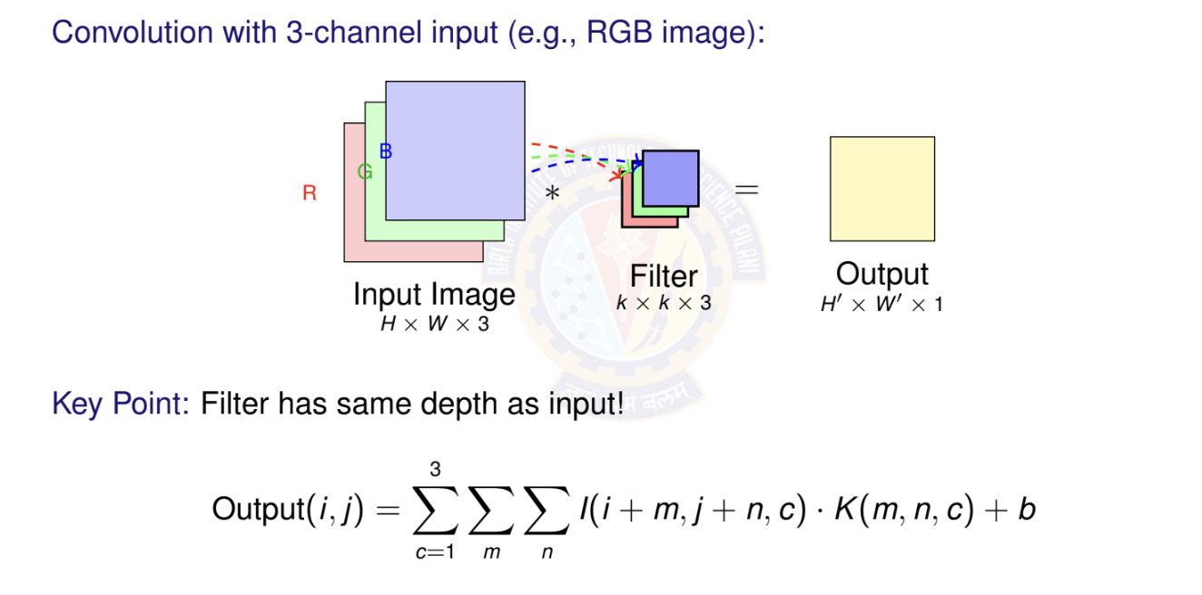
Multi-Channel Input: Single Filter

Slide 63
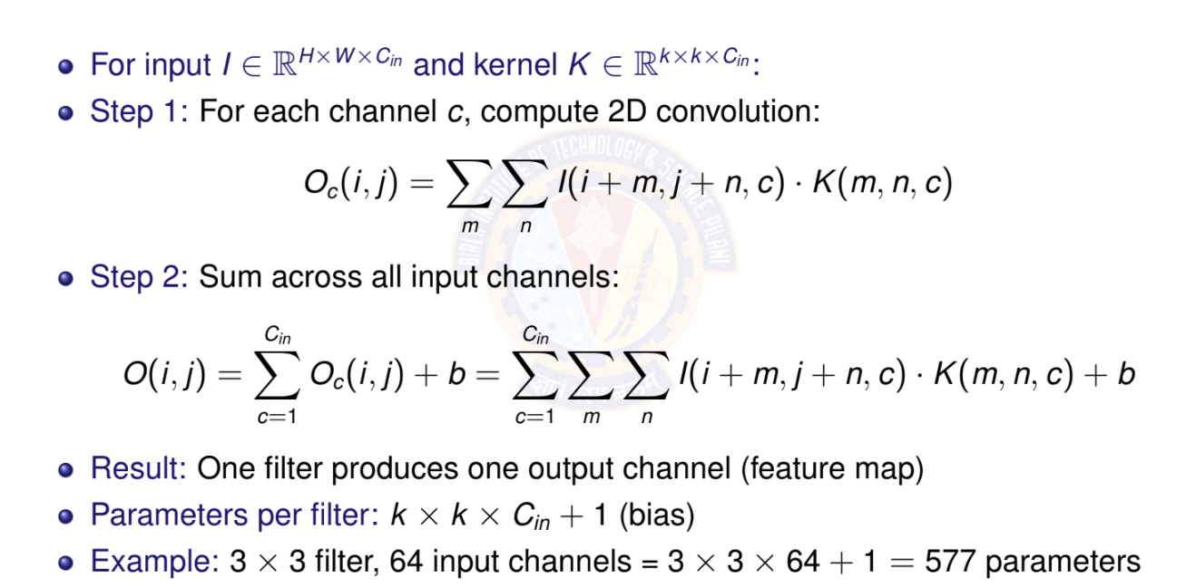
Multi-Channel Convolution: Mathematical

Slide 64
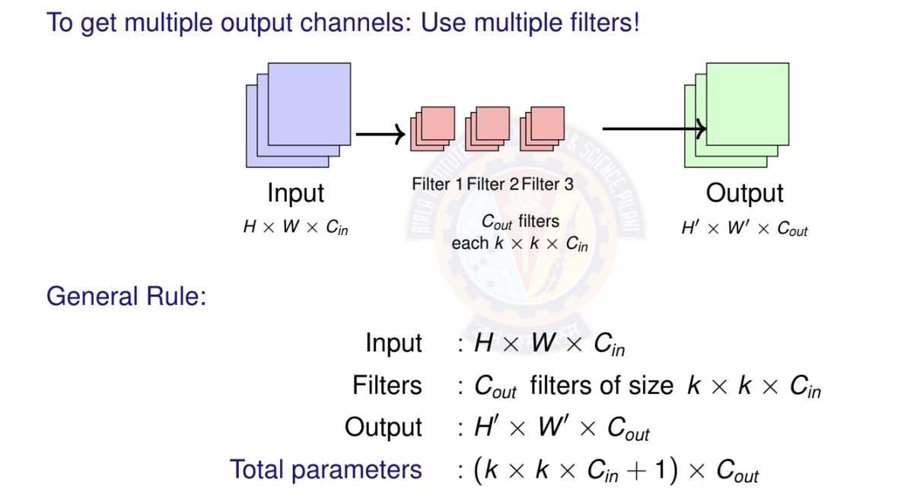
Multi-Channel Input and Output

Slide 65
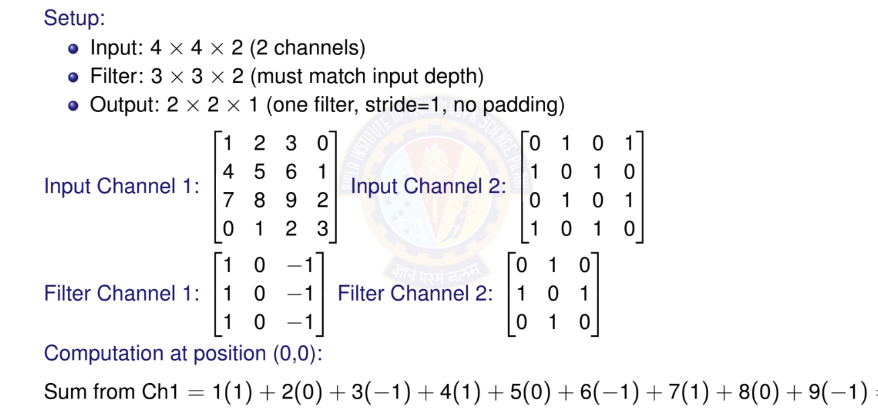
Multi-Channel Example: Numerical

Slide 66
Channel Evolution in Deep CNNs
Typical pattern: Increase channels while decreasing spatial dimensions
224 × 224
×3
112 × 112
56 × 56
28 × 28
14 × 14
×64
×128
×256
×512
Input
Conv1 Conv2 Conv3 Conv4
Why this pattern?
Early layers: High resolution, few channels (local patterns)
Deep layers: Low resolution, many channels (semantic features)
Maintains roughly constant computational cost per layer
Total information capacity: H × W × C approximately constant

Slide 67
Multi-Channel Convolution: Key Takeaway
Input channels: Filter depth = Input depth (must match)
Output channels: Number of filters = Number of output channels
Parameters: (k × k × C_{in} + 1) × C_{out}
Computation: Each filter operates on all input channels simultaneously
Important Relationships:
One filter → One output channel (feature map)
More filters → More output channels Network can learn more diverse features
Typical progression: Channels increase with depth (3 64 128 256 512)
Memory consideration: Deep networks trade spatial resolution for channel depth.
Memory ∝ H × W × C

Slide 68
Pooling Operations
What Pooling Layers Do
Spatial Downsampling: Reduce height and width dimensions but preserve channel depth.
Translation Invariance: Make features less sensitive to small shifts.
Computational Efficiency: Reduce number of computations in subsequent layers.
Overfitting Reduction: Act as a form of regularization.
Pooling layers are parameter-free but still important for network performance
Global Average Pooling (GAP) is used to replace fully connected layers.
Two types
Max pooling
Average pooling

Slide 69
Max Pooling
Takes maximum value in each region Most common pooling operation Preserves strongest activations
output = max(inputs in window)
Input 4 × 4
Output 2 × 2
2 | 4 | 7 | 4
6 | 6 | 9 | 8
3 | 4 | 8 | 3
7 | 5 | 3 | 6
Max pooling
k = 2
s = 2
→
→
6 | 9
7 | 8

Slide 70
Average Pooling
Takes average of values in region
Smoother downsampling
Used in final layers sometimes
output = ¹ (inputs in window)
_{k} 2
Input 4 × 4
Output 2 × 2
2 | 4 | 7 | 4
6 | 6 | 9 | 8
3 | 4 | 8 | 3
7 | 5 | 3 | 6
Average pooling
k = 2
s = 2
→
→
4.5 | 7
4.75 | 5

Slide 71
1 1 Convolution: Introduction
Definition
A 1×1 convolution uses a kernel of size 1 × 1 × C_{in} to perform a weighted sum across channels at each spatial location.
At First Glance:
Seems pointless: No spatial information, just a single pixel!
But actually very powerful: ”Network in Network”
What it does:
Combines information across channels
Acts as a learned linear combination
Does NOT look at neighboring pixels
Applied independently at each spatial position

Slide 72
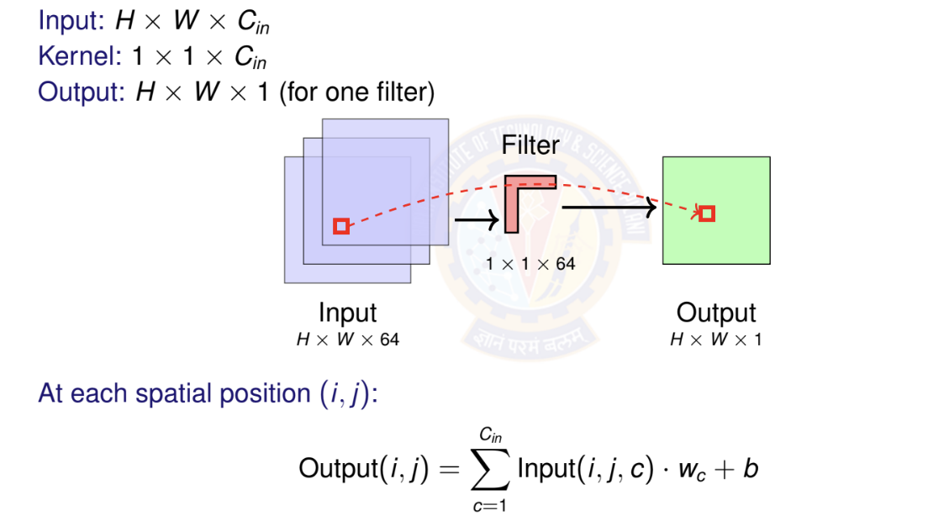
1 1 Convolution: How It Works

Slide 73

1 x 1 Convolution: Key Applications

Slide 74

1 x 1 Convolution: Bottleneck Architecture

Slide 75
ReLU Activation Function
Definition
ReLU (Rectified Linear Unit) is a simple and powerful activation function that outputs the input directly if positive, otherwise outputs zero.
Key Properties
Non-linear: Enables learning complex patterns
Sparse: Many outputs are exactly zero
Computationally efficient: Simple max operation
Non-saturating: No upper bound on positive values
Usage in CNNs ReLU is the default choice for activation functions in CNNs and is typically applied after each convolutional layer:
Conv Layer Output → ReLU → Next Layer

Slide 76

ReLU Activation Function

Slide 77
ReLU Activation Function
Advantages of ReLU
Solves Vanishing Gradient Problem: Gradient is either 0 or 1 (no saturation for positive values)
Computational Efficiency: No expensive operations (exp, log, etc.)
Sparse Representation: Naturally produces sparse networks
Biological Plausibility: Similar to neuron firing patterns
Scale Invariant: ReLU(αx ) = α · ReLU(x ) for α > 0
Disadvantages of ReLU
Dying ReLU Problem: Neurons can become permanently inactive (output always 0)
Not Zero-Centered: Output is always non-negative
Non-Differentiable at Zero: Can cause issues in some optimization scenarios

Slide 78
Convolution + ReLu + Max Pooling
Input Image 6 × 6
Convolve, s=1
1 | 0 | 0 | 0 | 0 | 1
0 | 1 | 0 | 0 | 1 | 0
0 | 0 | 1 | 1 | 0 | 0
1 | 0 | 0 | 0 | 1 | 0
0 | 1 | 0 | 0 | 1 | 0
0 | 0 | 1 | 0 | 1 | 0
-1 | -1 | -1 | -1
-1 | -1 | -2 | -1
-1 | -1 | -2 | 1
-1 | 0 | -4 | 3
Apply ReLU
Maxpool k=2, s=2
Filter
0 | 0 | 0 | 0
0 | 0 | 0 | 0
0 | 0 | 0 | 1
0 | 0 | 0 | 3
-1 | 1 | -1
-1 | 1 | -1
-1 | 1 | -1
0 | 0
0 | 3

Slide 79
Fully Connected (Dense) Layer
Definition
A Fully Connected (FC) Layer or Dense Layer is a layer where every neuron is connected to every neuron in the previous layer, performing a linear transformation followed by an activation function.
Role in CNN Architecture
Feature Flattening: Convert spatial features to vector:
(H × W × C) → (H · W · C)
Classification Head: Map features to class scores Dimensionality Control: Adjust feature vector size
Non-linear Mapping: Learn complex decision boundaries Typical CNN Flow:
Conv Layers → Flatten → FC Layer(s) → Output

Slide 80
Fully Connected (Dense) Layer
y = f (Wx + b)
x ∈ R^{n} : Input Vector
W ∈ R^{m×n} : Weight matrix
b ∈ R^{m} : Bias vector f (·): Activation function y ∈ R^{m} : Output vector
Parameter Count
Weights: n × m parameters Biases: m parameters
Total: n × m + m = m(n + 1)
FC Layer Architecture
^{w}11
b₃
x
4
y₃
y₂
x₃ x₂ x₁
W ^{b}
2
b
1
y
1
w
Input Layer
³¹ Output Layer
(n = 4)
(m = 3)

Slide 81

FC Layer - Numerical Example

Slide 82
FC - Advantages and Disadvantages
Advantages:
Universal Approximation: Can learn any function
Flexible Output Size: Any input
any output dimension
Non-linear Transformations: Complex mappings
Feature Integration: Combines all spatial information
Modern Alternatives
Disadvantages:
Parameter Heavy: Many parameters
→ overfitting risk
Spatial Information Loss: No spatial structure preservation
Fixed Input Size: Requires consistent input dimensions
Computational Cost: Matrix multiplication overhead
Global Average Pooling (GAP): Replace FC with average pooling
1×1 Convolutions: Maintain spatial structure while reducing channels

Slide 83
Softmax Activation Function
Definition
Softmax is an activation function that converts a vector of real numbers into a probability distribution, commonly used in the output layer for multi-class classification.
Usage in CNNs Softmax is typically used in the final layer for multi-class classifica- tion:
Final Conv/FC Layer → Softmax → Class Probabilities

Slide 84

Softmax Activation Function

Slide 85

Softmax - Numerical Example

Slide 86
Typical CNN Architecture
32×32×3
28×28×6
14×14×6
10×10×16
5×5×16
120
10
Input
Conv1 Pool1 Conv2 Pool2 FC
Output
Pattern: CONV → POOL →CONV →POOL →FC →OUTPUT
Early layers: Detect low-level features (edges, corners) Middle layers: Combine features (shapes, textures) Later layers: High-level concepts (objects, faces) Spatial size decreases, depth increases

Slide 87
Number of Parameters in Convolutional Layer
For a convolutional layer with: Kernel size: K × K
Input channels: C_{in}
Output channels (number of filters): C_{out}
Bias: Yes/No, Where bias = 1 if bias is used, 0 otherwise
Total Parameters = (K × K × C_{in} + bias) × C_{out}
Parameters are independent of input spatial dimensions (height, width) Each filter has the same depth as input channels
Number of parameters grows quadratically with kernel size Adding more filters increases parameters linearly

Slide 88
Number of Parameters in Convolutional Layer
Example 1: First Convolutional Layer
⁾ Input: RGB image
(224 × 224 × 3)
⁾ Kernel size: 5 × 5
⁾ Number of filters: 64
⁾ Bias: Yes
Calculation:
⁾ Parameters per filter
= 5 × 5 × 3 + 1 = 76
⁾ Total parameters
= 76 × 64 = 4, 864
Example 2: Deeper Convolutional Layer
⁾ Input: Feature map
(56 × 56 × 128)
⁾ Kernel size: 3 × 3
⁾ Number of filters: 256
⁾ Bias: Yes
Calculation:
⁾ Parameters per filter
= 3 × 3 × 128 + 1 = 1,153
⁾ Total parameters
= 1, 153 × 256 = 295,168

Slide 89
Number of Parameters in Pooling Layers
Key Insight
Pooling layers have ZERO learnable parameters!
Why Zero Parameters?
Pooling operations are fixed mathematical functions: max or average
No weights or biases to learn
Only hyperparameters: pool size k and stride s

Slide 90
Number of Parameters in Pooling Layers
Max Pooling Example
Input: (56 × 56 × 128)
Pool size: 2 × 2
Stride: 2
Output: (28 × 28 × 128)
Parameters: 0
Average Pooling Example Input: (56 × 56 × 128)
Pool size: 2 × 2
Stride: 2
Output: (28 × 28 × 128)
Parameters: 0

Slide 91
Design Patterns for Deep Networks
How do we design effective deep CNN architectures?
Key Design Patterns (Common to successful architectures):
Spatial reduction + Channel expansion Repetitive building blocks Skip/residual connections
Bottleneck designs
Multi-scale feature extraction
1
2
3
4
5
Goal: Balance between:
Model capacity (expressiveness) Computational efficiency Memory requirements
Training stability

Slide 92

Pattern 1: Spatial Reduction + Channel Expansion

Slide 93
Pattern 2: Repetitive Building Blocks
Instead of arbitrary layers, use repeated modular blocks
VGG Block:
Multiple 3×3 convs + pooling
VGG Block
ResNet Block:
Convs + skip connection
ResNet Block
Conv 3×3
Conv | 3×3
Conv | 3×3
Conv 3×3
MaxPool
+
Benefits: Modularity, easier to scale, proven designs

Slide 94


Pattern 3: Skip/Residual Connections
Problem: Deep networks suffer from vanishing gradients Solution: Add identity shortcuts (skip connections)
F (x)
x Weight Weight +
y
identity
y = F (x) + x
Key Benefits:
Easier gradient flow during backpropagation Network can learn identity mapping if needed
Enables training of very deep networks (100+ layers)
Used in ResNet, DenseNet, U-Net

Slide 95
Pattern 4: Bottleneck Designs
Goal: Reduce computational cost without sacrificing performance
Strategy: Use 1×1 convolutions to reduce dimensions before expensive operations 8× parameter reduction! Used in ResNet-50/101/152, Inception, MobileNet
Standard: Bottleneck:
256 ch
256 ch
1×1 Conv
Conv 3×3
590K params
64 ch
256 ch
Conv 3×3
70K params
64 ch
1×1 Conv
256 ch

Slide 96
Pattern 5: Multi-Scale Feature Extraction
Idea: Process input at multiple scales simultaneously Inception Module Example:
Concatenate
1×1
3×3
5×5
Pool
Input
Benefits:
Capture features at different scales More robust to object size variations
Network decides which scale is important

Slide 97
How to Choose Architecture Depth
Key Considerations:
1
Task complexity
⁾ Simple: MNIST 5-10 layers sufficient
⁾ Complex: ImageNet 50-152 layers
⁾ Very complex: Medical imaging 100+ layers
Dataset size
⁾ Small dataset (< 10K): Shallow network (avoid overfitting)
⁾ Medium (10K-100K): Moderate depth (20-50 layers)
⁾ Large (> 1M): Very deep (50-200 layers)
Computational budget
⁾ Mobile/edge: MobileNet, EfficientNet (10-20 layers)
⁾ Desktop/server: ResNet-50, VGG-16 (16-50 layers)
⁾ Data center: ResNet-152, EfficientNet-B7 (100+ layers)
2
3
Start shallow, add depth if underfitting and you have enough data

Slide 98
Architecture Depth: Practical Guidelines
Empirical observations:
Network | Layers | Params | Use Case
LeNet-5 | 5 | 60K | MNIST, simple tasks
AlexNet | 8 | 60M | ImageNet (2012)
VGG-16 | 16 | 138M | High accuracy, features
ResNet-50 | 50 | 25M | General purpose
ResNet-152 | 152 | 60M | State-of-art accuracy
EfficientNet-B0 | 18 | 5M | Mobile, efficient
Trends:
Modern architectures: 50-200 layers with skip connections Efficient architectures: 10-30 layers with smart design Depth alone is not enough: Need proper training techniques
Warning: Very deep networks require: Batch normalization

Slide 99
Trade-offs: Depth vs. Width
Depth: Number of layers (vertical stacking)
Width: Number of channels per layer (horizontal expansion)
Aspect | Deeper (More Layers) | Wider (More Channels)
Feature complexity | Higher | Moderate
Receptive field | Larger | Same
Parameters | Sub-linear growth | Quadratic growth
Training difficulty | Harder (vanishing grad) | Easier
Overfitting risk | Lower (if regularized) | Higher
Inference speed | Slower (sequential) | Faster (parallel)
Example:
ResNet-50: Deep (50 layers), moderate width (256-2048 channels) Wide ResNet: Fewer layers (16-28), very wide (up to 10× channels)
Current consensus: Depth + Width both matter; optimal ratio depends on task

Slide 100
Depth vs. Width: Practical Recommendations
When to go deeper:
⁾ Large, diverse datasets (ImageNet, COCO)
⁾ Complex tasks requiring hierarchical features
⁾ When you can use skip connections
⁾ Sufficient computational resources
When to go wider:
⁾ Smaller, more homogeneous datasets
⁾ Need faster training/inference
⁾ Limited to shallow networks (no residual connections)
⁾ Ensemble-like behavior (different filters learn different patterns)
Hybrid approach (EfficientNet):
⁾ Scale depth, width, AND resolution together
⁾ Use compound scaling: depth^{d} × width^{w} × resolution^{r} = 2
⁾ Achieves better accuracy-efficiency trade-off

Slide 101
Design Decision Framework
1
Start with baseline
⁾ Use proven architecture (ResNet, EfficientNet)
⁾ Transfer learning if possible
Estimate requirements
⁾ Dataset size depth constraint
⁾ Computational budget width/depth trade-off
⁾ Input resolution receptive field needs
Iterate systematically
⁾ Underfitting? Add depth or width
⁾ Overfitting? Regularize (dropout, data aug) before reducing capacity
⁾ Too slow? Reduce width or use efficient blocks
Apply design patterns
⁾ Always: Spatial reduction + channel expansion
⁾ Deep networks: Skip connections mandatory
⁾ Tight budget: Bottleneck designs
2
3
4

Slide 102


